Slide 1
Title is Franklin Gothic Medium, 32pt
Presenter Name
Month DD, YYYY
Controlled by:
CUI Category:
LDC/DISTRO
POC:
Notes:
Welcome to the new DHA PowerPoint template. Each slide contains helpful information for making the entire presentation user-friendly and accessible to people of all abilities.
Please note: if your presentation is being presented online, the PowerPoint file must be converted and remediated as a PDF.
A NOTE ABOUT CONTROL MARKINGS: Once you determine if your presentation needs security markings, please delete the irrelevant marking and re-center the box. This marking should be in the top center of each slide. To put it in the same place ever time, simply copy (Ctrl + C) from one slide and paste (Ctrl + V) on the next slide. There is no need to position a cursor to have it paste in the correct location.
Accessibility Note:
How to convert a PPT to PDF properly and ensuring accessibility fixes are preserved
[Select File > Export > Click ‘Create PDF/XPS Document’ > select ‘Create PDF/XPS’ > Choose location to save file to > Click ‘Publish’]
Please be advised, once a PowerPoint file is converted to a PDF, further accessibility testing is required to make document 508 compliant.
Check out the following Microsoft page to learn more about making your PowerPoint Accessible: Make your PowerPoint presentations accessible to people with disabilities - Microsoft Support
Please contact the Section 508 PMO (dha.ncr.j-6.mbx.dhasection508pmo@health.mil) to request additional resources.

Slide 2
IMPORTANT: Slide Dimensions
This template is formatted with 16:9 dimensions, which is the standard for displaying your presentation on wide-screen monitors.
Do NOT change the dimensions to the old standard of 4:3.
  Your presentation will not display properly on screens.
  It squeezes the logos, which is a violation of DHA branding standards.
  It also squeezes any template and other images placed in the 16:9 version, creating an unprofessional appearance.
Notes:
Accessibility Tips when presenting:
Presenting your PPT in Teams and ensuring it is accessible by all users
In Microsoft Teams, select ‘Share Content’ > Select ‘PowerPoint Live’ > Select the PowerPoint you would like to share
Note: Only the presenter will be able to see the presentation slides + presenter notes; viewer view is the presentation slides only.

Slide 3
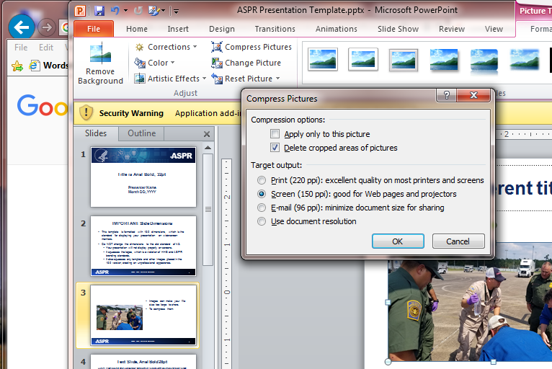
Compressing Images
Images can make your file size too large to share.
To compress them:
  Click on the picture, then “Format” on the picture tab
  Click “Compress Pictures”
  Uncheck “Apply only to this picture” to compress all images in the presentation and choose screen resolution
  Click OK
Notes:
Accessibility Tip for Images:
Graphic elements such as images or charts must have Alt text for screen reader accessibility [Right click image > Select ‘Edit ALT Text’ ]
Add ALT text to all SmartArt
Replicate ALL the text available in the SmartArt in the ALT text.
Adding additional information is optional.
All images require an alt text of 100 characters or less. When the alt text exceeds the 100-character limit, place long ALT text in the notes section.
Mark image as decorative when
Visual is purely decorative
Visual is redundant with the text
Definition:
ALT Text: Text alternatives ("alt text") convey the purpose of an image, including pictures, illustrations, charts, etc.
Long ALT Text: Complex images that contain substantial information – more than can be conveyed in a short phrase or sentence.
When adding Long ALT Text, make sure that:
short ALT text is added to identify the image and indicate that the location of the long description is available in the presenters' notes

Slide 4
Text Slide, Franklin Gothic Medium 28pt
This template was created in accordance with Section 508 of the Rehabilitation Act.
Adhering to the guidance in this template will ensure that your presentation is not only accessible, but also consistent and user-friendly for everyone.
  Each slide requires a unique title. No two slides should have the same title.
  Ensure hyperlinked text is clear, unique, and makes sense when announced in isolation. Limit each hyperlink to one line of text.
Notes:
Your slides are preformatted. It’s not necessary for you to change the colors or the list labels (bullets and numbers).
Adhering to the guidance in this template will ensure that your presentation is not only accessible, but also consistent and user-friendly for everyone.
Accessibility Tip for Slides:
Each slide requires a unique title. No two slides should have the same title.
Ensure hyperlinked text is clear, unique, and makes sense when announced in isolation. Limit each hyperlink to one line of text..
Do no use flashing, flickering, or animated text
Do not use slide transitions
Use Slide Layout Instead of Text Boxes

Slide 5
List Slide Franklin Gothic Medium, 28pt
Unordered lists begin with bullet points or shapes. Use these when the order of steps doesn’t matter – like your grocery list.
Ordered lists begin with numbers, roman numerals, or letters (1, I, A, a) and have a sequential order
If your list contains only one item, you can do one of two things:
  Remove the list label (number, letter, bullet, or symbol).
  Move the second level list item up to the first level.
Notes:
Accessibility Tips for List:
Use the ‘Bullets’ and/or ‘Numbering’ function to create an ordered and/or unordered list.
[Home > Paragraph group > Select Bullets or Numbering]
Unordered lists begin with bullet points or shapes. Use these when the order of steps doesn’t matter – like your grocery list.
Ordered lists begin with numbers, roman numerals, or letters (1, I, A, a) and have a sequential order
If your list contains only one item, you can do one of two things:
Remove the list label (number, letter, bullet, or symbol).
Move the second level list item up to the first level.

Slide 6
Columns Slide Franklin Gothic Medium, 28pt
The column slide is good for comparisons, for newspaper-style content, or to place an image next to text.
All images require an alt text of 100 characters or less.
When the alt text exceeds the 100-character limit, a content description is required.
Notes:
The column slide is good for comparisons, for newspaper-style content, or to place an image next to text.

Slide 7
Charts Slide Franklin Gothic Medium, 28pt
Notes:
Accessibility Tips for Graphs:
Color should not be the only way to convey information.
Graphs need to have data labels formatted to be Franklin Gothic Book 10.
Images of charts or graphs created in other applications may not accurately convey all necessary information to participants.
Use the chart feature of PowerPoint to add these type of graphics to the slide. Doing this exposes the tabular (Excel) information to participants who may not be able to see the image.
[Select the Insert tab > Chart >Select the type of chart to include]
Assign a title, legend, and axis labels to each chart.
Add ALT text
The alt text description should describe the relationship between the sections of the graph in approximately 100 characters.

Slide 8
Table Slide Franklin Gothic Medium, 28pt
Header 1 | Header 2 | Header 3 | Header 4
Data, R1C1 | Data, R1C2 | Data, R1C3 | Data, R1C4
Data, R2C1 | Data, R2C2 | Data, R2C3 | Data, R2C4
Data, R3C1 | Data, R3C2 | Data, R3C3 | Data, R3C4
Data, R4C1 | Data, R4C2 | Data, R4C3 | Data, R4C4
Data, R5C1 | Data, R5C2 | Data, R5C3 | Data, R5C4
Notes:
Accessibility Tips for Tables:
Insert tables into your presentation from the Insert tab above. Don’t copy and paste as an image of a table into the slide.
Use ‘add a table’ function to create a table
[select ‘insert’ tab > Select ‘Table’ > Select columns and rows for the table]
Make sure header row is selected for all tables
[Select image > Select ‘Table Design’ > Select ‘Header row’]
Column Headers can be identified as well in the table settings
Do not merge cells.
Reading order in the table should be left to right, top to bottom.
The table should also include a title and, if applicable, a short description if the table is too complex.

Slide 9
Conclusion Slide Franklin Gothic Medium, 28pt
Run the Accessibility Check
  Check the reading order of each slide
  Review all errors, warnings and intelligent service warnings
Set the title attribute in the Document Properties
Set a default language for the document
Notes:
Accessibility Tips for PowerPoints:
Run Accessibility Checker
[Review tab > select ‘Check accessibility’]
Check Reading order – verify that the reading order will make sense in the order they will be read back
Review accessibility errors
Specify Document Properties
[Select File Tab > Select ‘Info’ > Select ‘Properties’ > Select ‘Advanced Properties’ > select ‘Summary’ Tab]
Title of the document
Subject
Author
Company
Keywords
Specify Document Language
[Select ‘File’ Tab > Select ‘Info’ > Select ‘Properties’ > Select ‘Advanced Properties > Select the ‘Custom Tab’]
In the ‘Custom’ window, fill out the following information:
Name: Language
Type: Text
Value: English
Remember the following for File Naming Convention
No spaces or special characters in file name (!, @, #, $, %, ^, &, *, etc.)
Use underscores (_) in place of spaces
Try to keep it to 30 – 40 characters max
File name should reflect the content or a shorten name version of the presentation title

