Slide 1
Leading with an Ethics Mindset
Dr. Barclay P. Butler, Ph.D., MBA
Laurie Rafferty, J.D.
2019 Annual Ethics Training
26 September 2019
1300-1400

Slide 2
Presenters
Dr. Barclay P. Butler, Ph.D., MBA
Assistant Director for Management
Defense Health Agency
Falls Church, Virginia
Ms. Laurie Rafferty, J.D.
DHA Alternate Deputy Designated Agency Ethics Official
Associate General Counsel
Defense Health Agency
Falls Church, Virginia

Slide 3
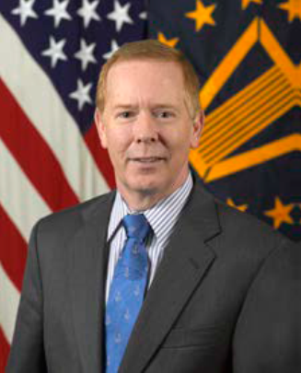
Dr. Barclay P. Butler, Ph.D., MBA
Dr. Barclay P. Butler serves as the Assistant Director for Management (AD-M) for the Defense Health Agency (DHA) as a member of the Senior Executive Service (SES).
As the AD-M, Dr. Butler is responsible for responsible for leading the DHA in matters pertaining to personnel, manpower, acquisition, contracting, program management, analytics, strategic planning, education and training, and research and development, serving the needs of primary, secondary, and tertiary care medical centers, hospitals, and ambulatory care clinics, within the Military Health System (MHS).
Prior to this assignment, Dr. Butler was the interim Assistant Director for Healthcare Administration (AD HCA) for the DHA responsible for strategy and execution in supporting the delivery of care to the beneficiaries of the MHS through the DHA’s integrated system of readiness and health where he led the DHA in the domains of financial operations, medical affairs, health care operations, and information operations, delivering the Quadruple Aim: increased readiness, better health, better care, and lower cost.

Slide 4
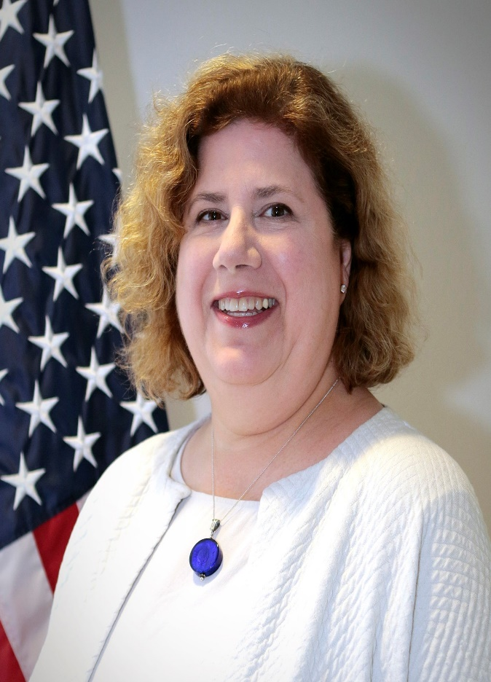
Laurie Rafferty, J.D.
Laurie Powell Rafferty is the lead ethics attorney for the Defense Health Agency (DHA). She has held this position since 2008. Prior to DHA, Laurie was an ethics attorney for the U.S. Department of Commerce, the National Aeronautics and Space Administration, and the U.S. Office of Government Ethics.
She has given numerous presentations on the Criminal Conflict of Interest Statutes and the Standards of Conduct regulation, and reviewed tens of thousands of financial disclosure reports.
Laurie also practiced in the Employment and Labor Law area for the Defense Contract Audit Agency, the Resolution Trust Corporation, and the Commerce Department.
Prior to her Government service, Laurie worked for a small, private law firm in Washington, DC. Laurie graduated from the College of William and Mary in Virginia with an AB in English, and the George Mason University School of Law with a JD.
She is a member of the Virginia, Maryland and District of Columbia bars.

Slide 5
Disclosures
Dr. Barclay P. Butler has no relevant financial or non-financial relationships to disclose relating to the content of this activity.
The views expressed in this presentation are those of the author and do not necessarily reflect the official policy or position of the Department of Defense, nor the U.S. Government.
This continuing education activity is managed and accredited by the Defense Health Agency J-7 Continuing Education Program Office (DHA J-7 CEPO). DHA J-7 CEPO and all accrediting organizations do not support or endorse any product or service mentioned in this activity.
DHA J-7 CEPO staff, as well as activity planners and reviewers have no relevant financial or non-financial interest to disclose.
Commercial support was not received for this activity.

Slide 6
Disclosures
Ms. Laurie Rafferty has no relevant financial or non-financial relationships to disclose relating to the content of this activity.
The views expressed in this presentation are those of the author and do not necessarily reflect the official policy or position of the Department of Defense, nor the U.S. Government.
This continuing education activity is managed and accredited by the Defense Health Agency J-7 Continuing Education Program Office (DHA J-7 CEPO). DHA J-7 CEPO and all accrediting organizations do not support or endorse any product or service mentioned in this activity.
DHA J-7 CEPO staff, as well as activity planners and reviewers have no relevant financial or non-financial interest to disclose.
Commercial support was not received for this activity.

Slide 7
Learning Objectives
At the conclusion of this activity, participants will be able to:
Identify a Financial Conflict of Interest.
Summarize an Appearance of Bias.
Discuss exceptions to the Gift Prohibition.
Explain post-government employment restrictions.

Slide 8
Secretary Esper’s “Reaffirming Our Commitment to Ethics Conduct” Memo

Slide 9
Memo Requires:
Reject any sense of personal entitlement, never abuse official position or privilege of service
Chose the harder virtue over the easier vice
To do what is right, must train & prepare
DoD leaders be personally involved in training their organizations and talk about examples of ethical decision-making--both good & bad examples

Slide 10
Topics
Financial Conflicts of Interest
Appearances of Bias
Gifts, Bribes & Salary Supplementation
Outside Employment & Activities
Political Activities
Misuse of Government Position & Resources
Seeking Employment & Post-Government Employment
Financial Disclosure

Slide 11
Financial Conflict of Interest
You cannot participate in matters in which you have a financial interest, or in which someone whose interests are imputed to you, has an interest.
Imputed interests are those of your:
  Spouse
  Minor children
  Organizations you serve as a fiduciary
  Prospective employer

Slide 12

Exemptions to General Rule
Widely diversified mutual funds
Sector specific mutual funds if all sector interests are valued at $50K or less
Stock worth $15K or less

Slide 13
Scenarios
You serve on a non-profit charitable board that helps inner-city kids with math, English, mentoring, and character building.
  (1) can the DHA award a contract to the non-profit to visit hospitals and serve children of beneficiaries?
Discussion

Slide 14

Appearances of Bias
You cannot participate in a matter as a government official if one of the parties to the matter is a person with whom you have a Covered Relationship
Covered Relationships:
  Person with whom you have or are seeking a business or financial relationship
  Members of your household

Slide 15

Covered Relationships, cont.
Close relatives
Employers and clients of your parents, dependent children and spouse
Former non-federal employers and clients (for one year, but two if you were paid an extraordinary severance payment)
Organizations in which you are an active participant

Slide 16
Scenarios
Your spouse or adult child works for a contractor who is bidding on a contract.
  Can you serve on the Source Selection Evaluation Board (SSEB)?
You serve on a board of a professional membership society.
  Can you attend their conference in an official capacity representing the DHA?
Discussion

Slide 17

Gifts, Bribes & Salary Supplementation
You cannot solicit or accept payment for taking or failing to take an action as a Federal employee or for performing your government job
You cannot accept gifts from people who contract with your agency, seek to contract with your agency or offer the gift because you are a government employee

Slide 18
Exceptions to the Gift Prohibition
If there is no appearance issue, then you can accept:
  Awards & honorary degrees
  Discounts & similar benefits
  Gifts valued at $20 or less (other than cash & up to $50 from the same donor in a year)
  Gifts of informational materials (up to $100)
  Widely attended gatherings (WAG)

Slide 19

Scenarios
A company supporting the DHA offers you a book on leadership and management valued at $30.
  You have not accepted any gifts from this company this year. Can you accept the book?
  You have accepted two lunches paid for by the company valued at a total of $25. Can you accept the book?
  You pay the company $30 for the book. Is this OK?
Discussion

Slide 20
Gifts Between Government Employees
You cannot offer a gift to your supervisor or accept a gift from your subordinate or someone who makes less pay
Exceptions:
  Bosses Day, birthdays, holidays where gifts are exchanged ($10 cap)
  Retirements (gift capped at $300 & no subordinate may be asked to contribute more than $10)
  Personal hospitality & food shared in the office

Slide 21

Scenarios
It’s the winter holiday season.
  Can you give the boss a bottle of wine?
  Can the boss give you a bottle of wine?
  Can the boss participate in a ‘white elephant’ gift exchange where the limit is $20 per gift?
Discussion

Slide 22
Outside Employment
You cannot engage in outside employment that conflicts with your DHA employment
You are prohibited from working for a foreign government
You are prohibited from representing third-parties back to the United States government

Slide 23

Scenarios
Due to your professional stature as a medical professional, you’re often sought out as a professional witness.
  You are asked to testify in a case against the Government. Can you participate?
  You are asked to testify in a case in the civilian sector in State court. Can you participate?
Discussion

Slide 24
Political Activities
You may not engage in partisan political campaign activities while on duty or on government premises or wearing anything that identifies you as a government employee
Less restricted employees may engage in partisan political activities off duty and away from government premises
Further restricted employees may only vote & contribute money up to the allowable limit

Slide 25

Scenarios
Can the AD-M work for a political campaign as a volunteer?
Can the AD-M contribute to a political campaign?
Can a General Schedule (GS) employee participate in a political campaign? If so, when and where?

Slide 26

Misuse of Government Resources
Government resources are only for permitted purposes—not for personal, commercial or partisan political purposes
Use of your public office for anyone’s private gain is prohibited
Use of government authority, to include business contacts obtained through your government employment is prohibited

Slide 27

Scenarios
I’m a laboratory technician or manager.
  Can I use a government-owned portable laboratory device to demonstrate a lab test as part of my child’s school’s science fair?
  Can I use a government-owned portable laboratory device to demonstrate a lab test as part of an recruiting campaign for interns for college math and science students?
Discussion

Slide 28

Post-Government Employment
Procurement Integrity Act
18 USC 207
One year compensation bar
For contracts > $10M
If you were the:
  Source Selection Authority (SSA)
  Member of the SSEB
  Chief/technical or scientific evaluation board
  Program Manager/Deputy Program Manager (PM/DPM)
  Contracting Officer
  Decision Maker (on payments & mods & task orders)
Representational Bars
  Lifetime for personal & substantial participation in a contract
  2 years for contracts that were pending under your official responsibility during your final year
  1 year cooling-off period for Senior Personnel that applies to their home agency

Slide 29

Scenarios
You are a GS employee. You were a member of the technical evaluation board for a contract valued at $15M.
  You are retiring. The contract will run for another four years. Can you work on that contract with your prospective new employer?
  You were the Chief of the technical evaluation board. Can you work on that contract with your prospective new employer?
Discussion

Slide 30

Financial Disclosure
If you are required to file a financial disclosure report, please fully report all reportable assets
  Not “various stocks & bonds”
  Not “401K” or “IRA” or “retirement account” and nothing more
  Not your spouse’s name but not his/her employer’s name

Slide 31

Remember: Stay on the Right Side

Slide 32

Contact Information
Laurie Rafferty
DHA’s Alternate Deputy Designated Agency Ethics Official
Laurie.p.rafferty.civ@mail.mil
703-681-6012

Slide 33
Key Takeaways
Do not work on matters in which you, or someone whose interests are imputed to you, have a financial interest.
Do not use your public office for someone’s private gain.
Seek post-government employment counseling before you start your job search.
Stay in the ethics mid-field.

Slide 34
References
Esper, Mark. (2019, August 19). Reaffirming Our Commitment to Ethics Conduct [ Memo written August 19, 2019 to: All Military Personnel and Department of Defense Employees].
Procurement Integrity Act, 41 U.S.C. §§ 2101-07 .
Shanahan, P. M. (2019, February 2). Leading with and Ethics Mindset [Memo written February 2, 2019 to Department of Defense Personnel]. Retrieved May 29, 2019, from: http://ogc.osd.mil/defense_ethics/resource_library/acting_secdef_shanaha n_leading _ethics_mindset_2019.pdf
United States of America. (n.d.). 18 U.S.C. § 207: Restrictions on former officers, employees, and elected officials of the executive and legislative branches. Retrieved from: https://www.govinfo.gov/content/pkg/USCODE-2012- title18/html/USCODE-2012-title18-partI-chap11-sec207.htm

Slide 35
How to Obtain CE Credit
To receive CE credits you must complete the course posttest and evaluation before collecting your certificate. The posttest and evaluation will be available from 17 September – 17 October 2019 at 2359 ET. Please complete the following steps to obtain CE credit:
Go to URL https://www.dhaj7-cepo.com/
In the search bar on the top left, copy and paste the activity name: Leading with an Ethics Mindset 2019. This will take you to the activity home page.
Click on the REGISTER/TAKE COURSE tab.
  If you have previously used the CEPO LMS, click login.
  If you have not previously used the CEPO LMS click register to create a new account.
Verify, correct, or add your profile information.
Follow the onscreen prompts to complete the post-activity assessments:
  Read the Accreditation Statement
  Complete the Evaluation
  Take the Posttest
After completing the posttest at 80% or above, your certificate will be available for print or download.
You can return to the site at any time in the future to print your certificate and transcripts at https://www.dhaj7-cepo.com/
If you require further support, please contact us at dha.ncr.j7.mbx.cepo-lms-support@mail.mil

