Slide 1
Leading with an Ethics Mindset Dr. Sean Biggerstaff, Ph.D. Ms. Laurie Rafferty, J.D. 2019 Annual Ethics Training 1 October 2019 1100-1200

Slide 2
Presenters
Sean Biggerstaff, Ph.D.
Acting Deputy Assistant Director for the Research & Development (R&D) Directorate
Defense Health Agency
Falls Church, Virginia
Ms. Laurie Rafferty, J.D.
DHA Alternate Deputy Designated Agency Ethics Official
Associate General Counsel
Defense Health Agency
Falls Church, Virginia

Slide 3
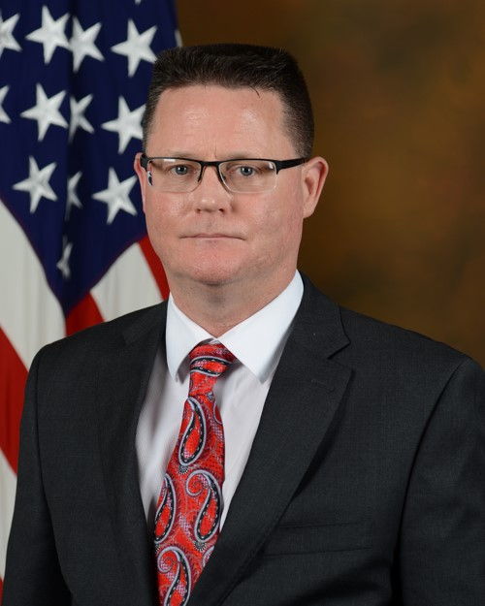
Sean Biggerstaff, Ph.D.
Dr. Sean Biggerstaff is the Acting Director for the Research & Development (R&D) Directorate, Defense Health Agency (DHA), Defense Health Headquarters, Falls Church, VA.
He leads a professional team that works to advance collaborative, innovative medical research and development to improve military community health and save lives on and off the battlefield.
He previously served 24 years on active duty as an Aerospace Experimental Psychologist in the U. S. Navy Medical Service Corps. Half of his career was spent working in biomedical research and research management, the other half working on human systems research, engineering and program management.
He received his undergraduate degree from the University of Texas at Austin, and attended graduate school at the University of Texas at Arlington, where he received his Ph.D. in Experimental Psychology in 1991.
Dr. Biggerstaff is level 3 certified in Program Management and Science &Technology Management.

Slide 4
Laurie Rafferty, J.D.
Laurie Powell Rafferty is the lead ethics attorney for the Defense Health Agency (DHA). She has held this position since 2008. Prior to DHA, Laurie was an ethics attorney for the U.S. Department of Commerce, the National Aeronautics and Space Administration, and the U.S. Office of Government Ethics.
She has given numerous presentations on the Criminal Conflict of Interest Statutes and the Standards of Conduct regulation, and reviewed tens of thousands of financial disclosure reports.
Laurie also practiced in the Employment and Labor Law area for the Defense Contract Audit Agency, the Resolution Trust Corporation, and the Commerce Department.
Prior to her Government service, Laurie worked for a small, private law firm in Washington, DC. Laurie graduated from the College of William and Mary in Virginia with an AB in English, and the George Mason University School of Law with a JD.
She is a member of the Virginia, Maryland and District of Columbia bars.

Slide 5
Disclosures
Dr. Sean Biggerstaff has no relevant financial or non-financial relationships to disclose relating to the content of this activity; or presenter(s) must disclose the type of affiliation/financial interest (e.g. employee, speaker, consultant, principal investigator, grant recipient) with company name(s) included.
The views expressed in this presentation are those of the author and do not necessarily reflect the official policy or position of the Department of Defense, nor the U.S. Government.
This continuing education activity is managed and accredited by the Defense Health Agency J-7 Continuing Education Program Office (DHA J-7 CEPO). DHA J-7 CEPO and all accrediting organizations do not support or endorse any product or service mentioned in this activity.
DHA J-7 CEPO staff, as well as activity planners and reviewers have no relevant financial or non-financial interest to disclose.
Commercial support was not received for this activity.

Slide 6
Disclosures
Ms. Laurie Rafferty has no relevant financial or non-financial relationships to disclose relating to the content of this activity; or presenter(s) must disclose the type of affiliation/financial interest (e.g. employee, speaker, consultant, principal investigator, grant recipient) with company name(s) included.
The views expressed in this presentation are those of the author and do not necessarily reflect the official policy or position of the Department of Defense, nor the U.S. Government.
This continuing education activity is managed and accredited by the Defense Health Agency J-7 Continuing Education Program Office (DHA J-7 CEPO). DHA J-7 CEPO and all accrediting organizations do not support or endorse any product or service mentioned in this activity.
DHA J-7 CEPO staff, as well as activity planners and reviewers have no relevant financial or non-financial interest to disclose.
Commercial support was not received for this activity.

Slide 7
Learning Objectives
At the conclusion of this activity, participants will be able to:
Identify a Financial Conflict of Interest.
Summarize an Appearance of Bias.
Discuss exceptions to the Gift Prohibition.
Explain post-government employment restrictions.

Slide 8
Secretary Esper’s “Reaffirming Our Commitment to Ethics Conduct” Memo

Slide 9
Memo Requires:
Reject any sense of personal entitlement, never abuse official position or privilege of service
Chose the harder virtue over the easier vice
To do what is right, must train & prepare
DoD leaders be personally involved in training their organizations and talk about examples of ethical decision-making--both good & bad examples

Slide 10
Topics
Financial Conflicts of Interest
Appearances of Bias
Gifts, Bribes & Salary Supplementation
Outside Employment & Activities
Political Activities
Misuse of Government Position & Resources
Seeking Employment & Post-Government Employment
Financial Disclosure

Slide 11
Financial Conflict of Interest
You cannot participate in matters in which you have a financial interest, or in which someone whose interests are imputed to you, has an interest.
Imputed interests are those of your:
Spouse
Minor children
Organizations you serve as a fiduciary
Prospective employer

Slide 12
Exemptions to General Rule
Widely diversified mutual funds
Sector specific mutual funds if all sector interests are valued at $50K or less
Stock worth $15K or less

Slide 13
Scenarios
Through the research process, I am frequently exposed to proposed work from companies with innovative technical capabilities. For example, when reviewing proposals for simulated virtual reality goggles, one small company demonstrated a non-public prototype that was vastly outperforming the competition. I recognized that this technology would be highly sought after and the company was destined for big things. However, because I was exposed to this technology as a result of my job, it is proprietary information that I could not share nor benefit from.

Slide 14
Appearances of Bias
You cannot participate in a matter as a government official if one of the parties to the matter is a person with whom you have a Covered Relationship
Covered Relationships:
Person with whom you have or are seeking a business or financial relationship
Members of your household

Slide 15
Covered Relationships, cont.
Close relatives
Employers and clients of your parents, dependent children and spouse
Former non-Federal employers and clients (for one year, but two if you were paid an extraordinary severance payment)
Organizations in which you are an active participant

Slide 16
Scenarios
I will gladly put in a good word for a colleague when it comes to potential job opportunities. However, I always make sure I am not on a selection committee in order to avoid a conflict of interest.
When I retired from active duty, I formed a Limited Liability Company (LLC) to potentially do consulting work. Firms immediately reached out to me and expressed interest in hiring me as a consultant. However, I had applied for a General Schedule (GS) position at DHA. I declined the work in order to protect those firms. I knew if I worked for them and then got the GS job they would be ineligible to receive funding through my organization.

Slide 17
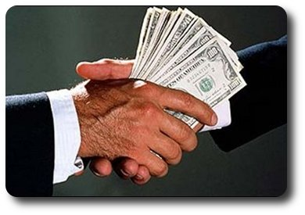
Gifts, Bribes & Salary Supplementation
You cannot solicit or accept payment for taking or failing to take an action as a Federal employee or for performing your government job
You cannot accept gifts from people who contract with your agency, seek to contract with your agency or offer the gift because you are a government employee

Slide 18
Exceptions to the Gift Prohibition
If there is no appearance issue, then you can accept:
Awards & honorary degrees
Discounts & similar benefits
Gifts valued at $20 or less (other than cash & up to $50 from the same donor in a year)
Gifts of informational materials (up to $100)
Widely attended gatherings (WAG)

Slide 19
Scenarios
I have attended a number of conferences where large government vendors host extravagant parties that are by invitation only. Some of these events feature things like free food and drinks, live music, and gifts such as cigars. As a precaution, I have always avoided these events.
Things we do out in public can quickly become fodder for Facebook, Twitter, etc. You don’t want to be pictured on social media doing something questionable.

Slide 20
Gifts Between Government Employees
You cannot offer a gift to your supervisor or accept a gift from your subordinate or someone who makes less pay
Exceptions:
Bosses Day, birthdays, holidays where gifts are exchanged ($10 cap)
Retirements (gift capped at $300 & no subordinate may be asked to contribute more than $10)
Personal hospitality & food shared in the office

Slide 21
Scenarios
When Rear Admiral (RADM) Doll was retiring, a number of people were planning to buy gifts. I asked someone close to him what he liked, and he mentioned that he was a big Pittsburgh Pirates fan and they had once attended a Pittsburgh Pirates baseball game versus the New York Yankees. With this in mind, I purchased an autographed Roberto Clemente photo, a Hall of Fame player for the Pirates. Subsequently, the DHA Director announced employees could not give gifts to their bosses. So, I kept the photo for myself and hung it up in my office.

Slide 22
Outside Employment
You cannot engage in outside employment that conflicts with your DHA employment
You are prohibited from working for a foreign government
You are prohibited from representing third-parties back to the United States government

Slide 23
Scenarios
I’ve always loved to teach, and there's nothing wrong with teaching on evenings and weekends as long as it doesn’t conflict with our DHA work. Prior to accepting any teaching opportunity, I made sure to inform the proper parties and sign all necessary forms to show there were no conflicts of interest.

Slide 24
Political Activities
You may not engage in partisan political campaign activities while on duty or on government premises or wearing anything that identifies you as a government employee
Less restricted employees may engage in partisan political activities
Further restricted off duty and away from government premises employees may only vote & contribute money up to the allowable limit

Slide 25
Scenarios
While serving in the military, I had a Commanding Officer who frequently and openly bad mouthed a presidency candidate. He continued to do so until the candidate was elected, at which point the bad mouthing finally stopped. This always made me uncomfortable because I knew it was not appropriate for him to openly express political opinions.
I make a conscious effort not to discuss politics in the workplace and on social media. I don’t even “like” posts on Facebook that are political in nature.

Slide 26
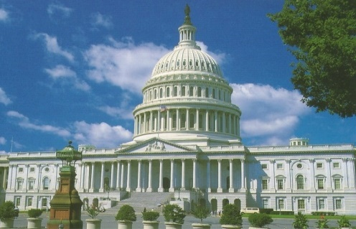
Misuse of Government Resources
Government resources are only for permitted purposes—not for personal, commercial or partisan political purposes
Use of your public office for anyone’s private gain is prohibited
Use of government authority, to include business contacts obtained through your government employment, is prohibited

Slide 27
Scenarios
Government Travel Cards are not for unofficial business/purchases.

Slide 28
Post-Government Employment
Procurement Integrity Act
18 USC 207
One year compensation bar
For contracts > $10M
If you were the:
Source Selection Authority (SSA)
Member of the Source Selection Evaluation Board (SSEB)
Chief/technical or scientific evaluation board
Program Manager/Deputy Program Manager (PM/DPM)
Contracting Officer
Decision Maker (on payments & mods & task orders)
Representational Bars
Lifetime for personal & substantial participation in a contract
2 years for contracts that were pending under your official responsibility during your final year
1 year cooling-off period for Senior Personnel that applies to their home agency

Slide 29
Scenarios
As a general rule, if I’ve had any interactions with a company prior to working with them, I ensure full transparency and document any prior involvement in a memo for record.
It is not uncommon for senior leaders to accept positions with contracting firms that do business with DHA; they have deep organizational knowledge and well established relationships. However, it is critical that both the company and the individual know the post-Government employment restrictions to avoid disqualification from business opportunities.

Slide 30
Financial Disclosure
If you are required to file a financial disclosure report, please fully report all reportable assets
Not “various stocks & bonds”
Not “401K” or “IRA” or “retirement account” and nothing more
Not your spouse’s name but not his/her employer’s name

Slide 31
Remember: Stay on the Right Side

Slide 32
Contact Information
Laurie Rafferty
DHA’s Alternate Deputy Designated Agency Ethics Official
Laurie.p.rafferty.civ@mail.mil
703-681-6012

Slide 33
Key Takeaways
Do not work on matters in which you, or someone whose interests are imputed to you, have a financial interest.
Do not use your public office for someone’s private gain.
Seek post-government employment counseling before you start your job search.
Stay in the ethics mid-field.

Slide 34
References
Esper, Mark. (2019, August 19). Reaffirming Our Commitment to Ethics Conduct [ Memo written August 19, 2019 to: All Military Personnel and Department of Defense Employees].
Procurement Integrity Act, 41 U.S.C. §§ 2101-07 .
Shanahan, P. M. (2019, February 2). Leading with and Ethics Mindset [Memo written February 2, 2019 to Department of Defense Personnel]. Retrieved May 29, 2019, from: http://ogc.osd.mil/defense_ethics/resource_library/acting_secdef_shanaha n_leading _ethics_mindset_2019.pdf
United States of America. (n.d.). 18 U.S.C. § 207: Restrictions on former officers, employees, and elected officials of the executive and legislative branches. Retrieved from: https://www.govinfo.gov/content/pkg/USCODE-2012- title18/html/USCODE-2012-title18-partI-chap11-sec207.htm

Slide 35
How to Obtain CE Credit
To receive CE credits you must complete the course posttest and evaluation before collecting your certificate. The posttest and evaluation will be available from 17 September – 17 October 2019 at 2359 ET. Please complete the following steps to obtain CE credit:
Go to URL https://www.dhaj7-cepo.com/
In the search bar on the top left, copy and paste the activity name: Leading with an Ethics Mindset 2019. This will take you to the activity home page.
Click on the REGISTER/TAKE COURSE tab.
If you have previously used the CEPO LMS, click login.
If you have not previously used the CEPO LMS click register to create a new account.
Verify, correct, or add your profile information.
Follow the onscreen prompts to complete the post-activity assessments:
Read the Accreditation Statement
Complete the Evaluation
Take the Posttest
After completing the posttest at 80% or above, your certificate will be available for print or download.
You can return to the site at any time in the future to print your certificate and transcripts at https://www.dhaj7-cepo.com/
If you require further support, please contact us at dha.ncr.j7.mbx.cepo-lms-support@mail.mil

