Slide 1
Home Study- Southern Hemisphere Influenza Vaccine Implementation Brief

Slide 2
Presenter: CAPT (Ret.) Jay Montgomery, MD
Dr. Jay Montgomery is a Board Certified Family Physician with specialty training in Allergy and Immunology. He received his medical training at Balboa Naval Hospital and Camp Pendleton Naval Hospital. He completed his Allergy & Immunology Fellowship at Walter Reed Army Medical Center. He is a Fellow of the American Academy of Family Physicians and the American Academy of Allergy, Asthma, and Immunology. Prior to Captain Montgomery’s retirement from the United States Navy in 2007, he served as the Chief of the Allergy and Immunology Service, National Naval Medical Center and Specialty Leader for the Navy Surgeon General. He also served as Specialty Consultant to the White House Medical Unit from 2003 to 2016. Currently, he is the Director of the Defense Health Agency’s Immunization Healthcare Branch’s North Atlantic Region Vaccine Office. He is credentialed at the Walter Reed National Military Medical Center, Ft. Belvoir Community Hospital, and the Portsmouth Naval Medical Center. He has published in Allergy and Asthma Proceedings, the Journal of the American Academy of Dermatology, Neurology, the Journal of Clinical Infectious Diseases, Human Vaccines and Immunotherapeutics, Military Medicine, Navy Medicine, the CDC’s Morbidity and Mortality Weekly Report (MMWR), the AFHSB’s Medical Surveillance Monthly Report (MSMR), and Retina.

Slide 3
Presenter: Tara Reavey, RN, BSN
Ms. Reavey is Chief of the Policy and Program Management section of the DHA Immunization Healthcare Branch. She received her Bachelor of Science in Nursing from Georgetown University. Ms. Reavey is a former Army Public Health Nurse and upon leaving the Army joined the Military Vaccine Agency. She has been with the organization since 2006, serving as the prior Chief of Education and Training to her current role today.

Slide 4
Disclosure
Dr. Jay Montgomery and Ms. Tara Reavey have no relevant financial or non-financial relationships to disclose relating to the content of this activity; or presenter(s) must disclose the type of affiliation/financial interest (e.g. employee, speaker, consultant, principal investigator, grant recipient) with company name(s) included.
The materials presented reflects the official policy and position of the Department of Defense (DoD), as outlined in the March 20th Southern Hemisphere Influenza Vaccine Interim Procedures Memorandum.
This continuing education activity is managed and accredited by the Defense Health Agency J-7 Continuing Education Program Office (DHA J-7 CEPO). DHA J-7 CEPO and all accrediting organizations do not support or endorse any product or service mentioned in this activity.
DHA J-7 CEPO staff, as well as activity planners and reviewers have no relevant financial or non-financial interest to disclose.
Commercial support was not received for this activity.

Slide 5
Learning Objectives
At the end of this activity, students will be able to:
Explain the policy for the use of the new Southern Hemisphere (SH) influenza vaccine.
Differentiate the differences between the Southern and Northern Hemisphere vaccines.
Distinguish the circumstances when a Southern Hemisphere influenza vaccine may be recommended.
Outline the processes for Southern Hemisphere influenza vaccine administration, including changes in the screening form, the competency assessment, and standing orders.

Slide 6
Why Are There Different Flu Vaccines?
The influenza virus mutates continuously. The most common strains of the influenza virus around the world change 80-90% year to year.
Flu is most common during the cooler months. Therefore in the Northern Hemisphere, the flu season is generally October - March, while in the Southern Hemisphere, the flu season is generally April - September.
About 60% of the time for a given season, the strains most common in the Northern Hemisphere are not the same as what started out in the Southern Hemisphere.
Flu vaccines are based upon our best estimate of which strains will be most common during each season. When the strains in the vaccine match the circulating strains, the flu vaccine is about 60% effective, but if one or more strains is mismatched in the vaccine, then the efficacy goes down.

Slide 7
Northern and Southern Hemisphere Influenza Zones
Equator
Notes:
Note what is southern and what is northern hemisphere vaccine regions is not as simple as checking the map

Slide 8
Northern and Southern Hemisphere Influenza Zones
Vaccination Zone | Countries, areas or territories
Southern Hemisphere - South America (including part of Central America and parts of the Caribbean) * | Anguilla, Antigua and Barbuda, Argentina, Bahamas, Barbados, Belize, Bolivia (Plurinational State of), Brazil, Cayman Islands, Chile, Colombia, Costa Rica, Dominica, Dominican Republic, Ecuador, El Salvador, French Guiana, Grenada, Guyana, Haiti, Honduras, Montserrat, Netherlands Antilles, Nicaragua, Panama, Paraguay, Peru, Saint Kitts and Nevis, Saint Lucia, Saint Vincent and the Grenadines, Suriname, Trinidad and Tobago, Turks and Caicos Islands, Uruguay, Venezuela (Bolivarian Republic of)
Southern Hemisphere - Southern and Western Africa | Benin, Cabo Verde, Cameroon, Central African Republic, Côte d'Ivoire, Gambia, Ghana, Guinea, Guinea-Bissau, Liberia, Nigeria, Senegal, Sierra Leone, Togo, Uganda, Angola, Botswana, Mozambique, Namibia, South Africa, Zambia, Zimbabwe
Southern Hemisphere - Tropical Asia | Bangladesh, Bhutan, Cambodia, India, Laos, Maldives, Myanmar, Nepal, Philippines, Thailand, Timor-Leste, Viet Nam
Southern Hemisphere - Oceania | Australia, New Zealand
* Cuba has been removed from the World Health Organization (WHO) country list for Southern Hemisphere vaccines. Due to the restricted access of personnel at Guantanmo Bay Cuba, they will not be required to receive the Southern Hemisphere vaccine but will be required to remain current for the Northern Hemisphere vaccine.
Notes:
Here is a list of southern hemisphere vaccination zones that will be found in the current instructions. Notice issue with Cuba.

Slide 9
Why the DoD implemented the Southern Hemisphere influenza vaccine
Over the years, the Department of Defense (DoD) has been aware of a substantial number of influenza-like illnesses occurring among our service members and other participants in multi-nations exercises conducted in the Southern Hemisphere during SH flu season.
Unfortunately, before the 2019 season, the DoD didn’t have a Food and Drug Administration (FDA)-approved vaccine to provide to our service personnel and their families stationed in, or on Temporary Duty Assignment (TDY) to, the Southern Hemisphere during its flu season.
In deploying this vaccine now, the DoD is mirroring the new Centers for Disease Control and Prevention (CDC) immunization guidelines. Before there was an FDA-approved SH vaccine, the CDC recommended using Northern Hemisphere (NH) vaccine if living in or going to the SH during SH flu season, even knowing the NH vaccine was not as effective.
Travelers who want to reduce their risk for influenza infection should consider influenza vaccination, preferably at least 2 weeks before departure to optimize effectiveness upon arrival.

Slide 10
Southern Hemisphere Influenza Vaccine Requirements and Recommendations
Southern Hemisphere influenza vaccination is required for all Active Duty (AD), Reserve Component (RC), Guard members (and recommended for all other beneficiaries), permanently or temporarily assigned for at least 14 days between April through September to an area designated as a Southern Hemisphere influenza zone by the WHO.
Family members who are living in or on Permanent Change of Station (PCS) to the Southern Hemisphere are authorized to receive the Southern Hemisphere vaccine.
Personnel traveling to the Southern Hemisphere between April and September should be vaccinated at least two weeks prior to entry into the region, if possible.
Notes:
ERROR

Slide 11
Southern Hemisphere Influenza Vaccine Requirements and Recommendations
Individuals can receive both the Southern and Northern Hemisphere influenza vaccines within a 12 month period if their travels take them into both hemispheres for longer than 14 days during the respective flu seasons. However, the two vaccines should be separated by 28 days.
Personnel traveling/residing in the Northern Hemisphere for at least 14 days between October to March, and have not previously received the current seasonal Northern Hemisphere influenza vaccine, are required to receive a Northern Hemisphere vaccine in accordance with the most current Defense Health Agency-Interim Procedures Memorandum (DHA-IPM) for Northern Hemisphere seasonal influenza vaccination program.
Notes:
ERROR

Slide 12
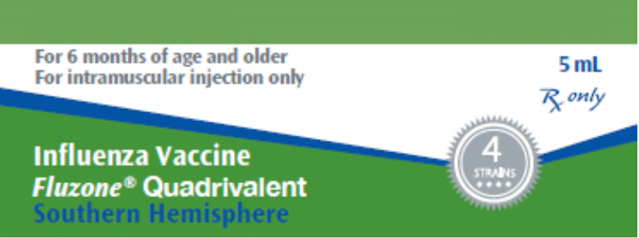
Fluzone® Southern Hemisphere Influenza Vaccine
Sanofi Pasteur manufacturers the only U.S. licensed Southern Hemisphere influenza vaccine, Fluzone® Quadrivalent – Southern Hemisphere, which received FDA licensure in 2018.
While Southern Hemisphere Fluzone® Influenza vaccine might differ in viral composition from the Northern Hemisphere Fluzone® formulation (1 vaccine strain change ~40%; 2 strains change ~12%; 3 strain change ~5%), it otherwise contains the same components (preservatives, stabilizers, etc.) as the Northern Hemisphere Fluzone® vaccine.
Other brands of Southern Hemisphere seasonal influenza vaccines are not licensed by the FDA and therefore not available in the United States.
MMWR / August 23, 2019 / Vol. 68 / No. 3

Slide 13
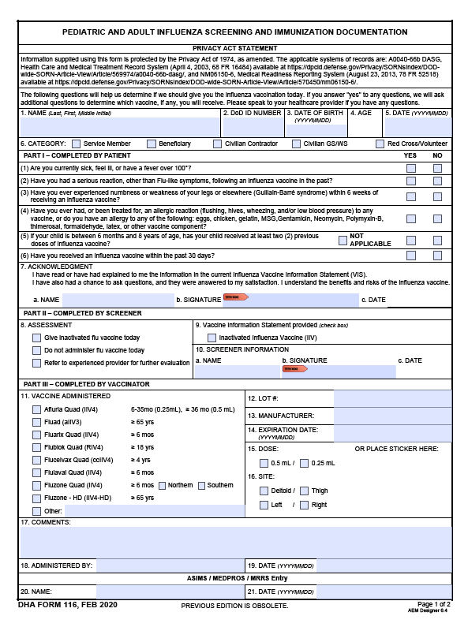
Administration of the Southern Hemisphere Influenza Vaccine
Screening, indications, contraindications, and administration of the southern hemisphere vaccine is identical to that of the northern vaccines.
Screening for all influenza immunizations (children or adults, Northern or Southern vaccines) can be accomplished with the updated DHA 116 screening form available on our website.
New form can be filled out on a tablet, computer, or paper (including multicopy)
New form has check box for Northern and Southern Formulations of Fluzone
Southern Hemisphere influenza vaccines may be administered concurrently with other inactivated or live vaccines (at different anatomic sites)

Slide 14
Administration of the Southern Hemisphere Influenza Vaccine
Adverse reactions: Local reactions are common after administration of either Fluzone formulation. Reactions include soreness (67%), redness (34%) and swelling (25%) and generally last 1-2 days. Systemic reactions include fever >100.4°F (7%), headache (23%), malaise (32%), and muscle aches (39%). Hypersensitivity (allergy) to vaccine components is rare, but may occur.
Pregnancy
Another FDA/Advisory Committee on Immunization Practices (ACIP) disconnect:
FDA- Fluzone Quadrivalent should be given to a pregnant woman only if clearly needed.
ACIP - pregnant women should get an influenza vaccine during any trimester of their pregnancy

Slide 15
Administration of the Southern Hemisphere Influenza Vaccine
Only appropriately trained and qualified medical personnel working within their scope of practice, upon the order (including standing orders) of an appropriately privileged healthcare provider, will administer the influenza vaccine.
Joint Knowledge Online (JKO) training (for NH vaccine) counts for administering SH vaccine
On-site training provided by a Regional Vaccine Safety Hub
The Influenza Immunization Competency Assessment form has been amended to read:
Vaccine Administration Procedures: Selects appropriate influenza product based on age, time of year and geographic location (NH/SH), and screening of patient. NOTE: For individuals in the NH between Oct & Mar, any age appropriate influenza formulation may be use. For those who will be in the SH between Apr & Sep, Fluzone SH, if available, is appropriate.

Slide 16
Administration of the Southern Hemisphere Influenza Vaccine
Standing Orders have been amended to read:
All eligible individuals are recommended to receive influenza vaccination each year based upon their geographic exposure during respective influenza season in the Northern Hemisphere or the Southern Hemisphere.
Individuals will be provided the current Influenza Vaccine Information Statement (VIS) from the CDC. The VIS covers both the Northern and Southern Hemisphere injectable vaccines.
Personnel who remain in the Southern Hemisphere during the Northern Hemisphere influenza season will not be required to receive the Northern Hemisphere influenza vaccine.

Slide 17
Administration of the Southern Hemisphere Influenza Vaccine
Fluzone®, Quadrivalent, Northern and Southern Hemisphere
Route: Intramuscular
Dosing:
* Children 6 months through 8 years old may need two doses, depending on their vaccination history. Two doses are needed for children receiving influenza vaccine for the first time and for any child who has not received two doses of vaccine prior to the end of the last influenza season (even if given in different seasons). The interval between the two doses should be at least four weeks.
Age | Dose | Series and Spacing
6-35 Months | 0.25 or 0.5 mL | 1 or 2 doses* 4 weeks apart
36 Months – 8 Years | 0.5mL | 1 or 2 doses* 4 weeks apart
9 Years and older | 0.5mL

Slide 18
Southern Hemisphere Influenza Vaccine DHA-IPM Ordering, Distribution, & Cold Chain Management
All routine vaccine cold chain procedures remain the same for the Southern Hemisphere vaccine
Fluzone®, Quad Southern Hemisphere vaccine is a refrigerated product and must be stored at 2° to 8° C
For references for proper cold chain and off site immunizations please see the DHA Immunization Healthcare Division (IHD) webpage for further information
All orders for Southern Hemisphere influenza vaccine must be placed through the respective Service Medical Logistics Influenza coordinators utilizing the same format for ordering Northern Hemisphere influenza vaccine
Priority for vaccine shipments will be for overseas locations and for units deploying to the Southern Hemisphere. Vaccine supplies will be monitored and released accordingly.
Notes:
IS THIS SLIDE / INFO NEEDED?

Slide 19
Southern Hemisphere Influenza Vaccine DHA-IPM Documentation
All IMR systems and electronic medical records have been provided the Vaccine Administered (CVX) code for Southern Hemisphere vaccination documentation. Systems are working to load the code and program the logic for it to reflect in the various location requirements.
CVX Code 194, Influenza, Southern Hemisphere, unspecified will be used to document Fluzone® Quad Southern Hemisphere pre-filled syringes.
Accurate documentation of the correct code is critical for the various systems to compute medical readiness
Code 194 should be reflected in immunization records as Southern Hemisphere Influenza
Individuals in the Southern Hemisphere will remain medically ready if they have a documented SH vaccine and will not be required to receive the Northern Hemisphere vaccine, unless traveling to NH.

Slide 20
Key Takeaways
Southern Hemisphere (SH) influenza vaccination is required for all AD, RC, NG members (and recommended for all other beneficiaries), permanently or temporarily assigned for at least 14 days between April through September to an area designated as a SH influenza zone by the World Health Organization.
Individuals can receive both the SH and NH influenza vaccines within a 12 month period. However, the two vaccines should be separated by 28 days.
Personnel who remain in the SH during the NH influenza season will not be required to receive the NH influenza vaccine.
All orders for SH influenza vaccine must be placed through the Service Medical Logistics Influenza vaccine coordinators utilizing the same format as ordering NH influenza vaccine.
CVX Code 194, Influenza, Southern Hemisphere, unspecified will be used to document Fluzone® Quad Southern Hemisphere pre-filled syringes.

Slide 21
Questions?
Please send any questions pertaining to Southern Hemisphere Influenza Vaccine to dodvaccines@mail.mil

Slide 22
References
Grohskopf L.A., Alyanak E., Broder K.R., Walter E.B., Fry A.M., Jernigan D.B. (2019). Prevention and Control of Seasonal Influenza with Vaccines: Recommendations of the Advisory Committee on Immunization Practices - United States, 2019-20 Influenza Season. Morbidity and Mortality Weekly Report, Recommendations and Reports, 68(3), 1-21. https://doi.org/10.15885/mmwr.rr6803a1
Sanofi Pasteur. (2019). Fluzone Quadrivalent Southern Hemisphere Influenza Vaccine- Package Insert. https://www.fda.gov/media/120054/download
Vaccine-Preventable Diseases. (n.d.). Military Health System.
https://www.health.mil/Military-Health-Topics/Health-Readiness/Immunization-Healthcare/Vaccine-Preventable-Diseases
WHO-Which vaccine formulation to use – Northern or Southern Hemisphere? (n.d.) World Health Organization. https://www.who.int/influenza/vaccines/tropics/vaccination_formulation/en/

Slide 23
How to Obtain CE/CME Credit
The course is available until 08 May 2021 at 2359 ET. To receive CE/CME credit, you must complete the program posttest and evaluation before collecting your certificate. Please complete the following steps to obtain CE/CME credit:
Go to URL https://www.dhaj7-cepo.com/
Search for your course using the Catalog, Calendar, or Find a course search tool.
Click on the REGISTER/TAKE COURSE tab.
If you have previously used the CEPO CMS, click login.
If you have not previously used the CEPO CMS click register to create a new account.
Enter the Access Code: FLU0408
Follow the onscreen prompts to complete the post-activity assessments:
Read the Accreditation Statement
Complete the Evaluation
Take the Posttest
After completing the posttest at 80% or above, your certificate will be available for print or download.
You can return to the site at any time in the future to print your certificate and transcripts at https://www.dhaj7-cepo.com/
If you require further support, please contact us at dha.ncr.j7.mbx.cepo-cms-support@mail.mil

