Slide 1
Breast cancer screening: Women’s attitudes and beliefs in light of new guidelines
Army Lt. Col. Jane Doe, M.D. Chief, Women’s Health Clinical Communities Defense Health Agency, Va
[Date]
Notes:
Welcome to the new DHA PowerPoint template. Each slide contains helpful information for making the entire presentation user-friendly and accessible to people of all abilities.
Please note: if your presentation is being presented online, the PowerPoint file must be converted and remediated as a PDF.
A NOTE ABOUT CONTROL MARKINGS: Once you determine if your presentation needs security markings, please delete the irrelevant marking and re-center the box. This marking should be in the top center of each slide. To put it in the same place ever time, simply copy (Ctrl + C) from one slide and paste (Ctrl + V) on the next slide. There is no need to position a cursor to have it paste in the correct location.
Accessibility Note:
How to convert a PPT to PDF properly and ensuring accessibility fixes are preserved [Select File > Export > Click ‘Create PDF/XPS Document’ > select ‘Create PDF/XPS’ > Choose location to save file to > Click ‘Publish’]
Please be advised, once a PowerPoint file is converted to a PDF, further accessibility testing is required to make document 508 compliant.
Check out the following Microsoft page to learn more about making your PowerPoint Accessible: Make your PowerPoint presentations accessible to people with disabilities - Microsoft Support
Please contact the Section 508 PMO (dha.ncr.j-6.mbx.dhasection508pmo@health.mil) to request additional resources.

Slide 2
Presenter(s)
Presenter’s name and credentials
Title (include “contract support for” when applicable)
Division
Agency
Location

Slide 3
Army Lt. Col. Jane Doe, M.D.
Presenter professional photo on the left side
Brief biography on this side

Slide 4
Disclosures
Dr. Jane Doe has no relevant financial or non-financial relationships to disclose relating to the content of this activity; OR Dr. Jane Doe [insert type of financial relationship (e.g., is a speaker for, holds stock in, conducts research for)] [insert company name(s)]. All relevant financial relationships have been mitigated.
The views expressed in this presentation are those of the author and do not necessarily reflect the official policy or position of the Department of Defense, nor the U.S. Government.
This continuing education activity is managed and accredited by the Defense Health Agency, J-7, Continuing Education Program Office (DHA, J-7, CEPO). DHA, J-7, CEPO and all accrediting organizations do not support or endorse any product or service mentioned in this activity.
DHA, J-7, CEPO staff, as well as activity planners and reviewers have no relevant financial or non-financial relationships to disclose.
Commercial support was not received for this activity.

Slide 5
Learning Objectives
At the conclusion of this activity, participants will be able to:
Summarize American College of Surgeons advocacy efforts in response to opioid abuse.
Compare chemotherapy and biotherapy drugs used to treat autoimmune diseases.
Differentiate between the forms of health information exchange and appropriate use of each form.

Slide 6
Main Presentation
Body of the presentation goes here
Use as many slides as you want, keeping in mind of the allotted time to present
Abbreviations must be defined where they first appear
Images, charts and graphs must be cited
Q&A may be part of the presentation (CE credit hours)

Slide 7
Key Takeaways
A.K.A. Summary/Conclusion
3-5 bullets of what you want the participants to remember from your presentation
Example 1: The first meeting is very important in establishing and effective relationship.
Example 2: Sleep deprivation is a significant issue impacting Service Members in garrison, in theater, and on operational platforms
Example 3: Shift work is especially challenging with its impact on sleep, research is ongoing to try to positively impact sleep to shift workers.

Slide 8
References
Use APA 7 format (for journal articles, look it up on Google Scholar and hit “Cite” to copy citation)
References not older than 5 years, unless it’s historical data.
You may use as many slides as necessary.
Examples:
Kennedy, C. H., & Zillmer, E. A. (Eds.). (2022). Military psychology: Clinical and operational applications. Guilford Publications.
Accreditation Council for Continuing Medical Education. (2020). Standards for integrity and independence in accredited continuing education. https://accme.org/wp-content/uploads/2020/12/884_20241028_standardsforintegrityandindependenceinaccreditedcontinuingeducation-1.pdf

Slide 9
TXA in Combat Results: Death Due to Blood Loss

Slide 10
Continued Management

Slide 11
Questions?

Slide 12
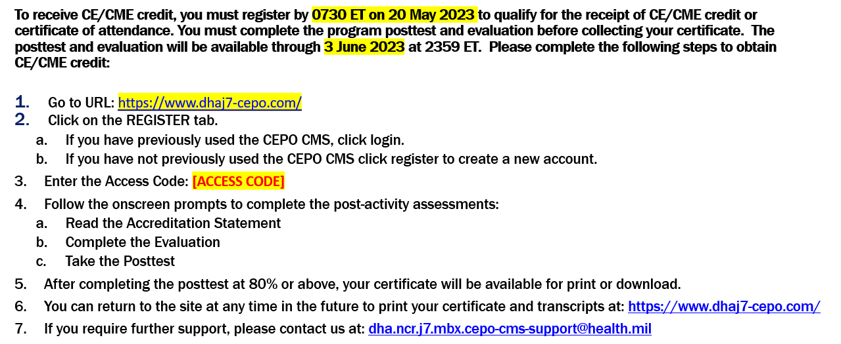
How to Obtain CE Credits
Placeholder
CEPO to update

